Slide 1

Stifel Jaws & Paws Conference
May 31, 2023

Slide 2
Disclaimer
CAUTIONARY NOTE REGARDING FORWARD-LOOKING STATEMENTS
This presentation contains forward-looking statements within the meaning of federal securities laws, including, among others, any statements about our expectations, plans, intentions, strategies or prospects. We generally use the words “may,” “will,” “expects,” “believes,” “anticipates,” “plans,” “estimates,” “projects,” “assumes,” “guides,” “targets,” “forecasts,” “sees,” “seeks,” “should,” “could,” “would,” “predicts,” “potential,” “strategy,” “future,” “opportunity,” “work toward,” “intends,” “guidance,” “confidence,” “positioned,” “design,” “strive,” “continue,” ”track,” “look forward to,” and similar expressions to identify forward-looking statements. All statements other than statements of historical or current fact are, or may be deemed to be, forward-looking statements. Such statements are based upon the current beliefs, expectations and assumptions of management and are subject to significant risks, uncertainties and changes in circumstances that could cause actual outcomes and results to differ materially from the forward-looking statements. These risks, uncertainties and changes in circumstances include, but are not limited to: the effects of the COVID-19 global pandemic and other adverse public health developments on the global economy, our business and operations and the business and operations of our suppliers and customers, including the deferral of elective procedures and our ability to collect accounts receivable; dependence on new product development, technological advances and innovation; shifts in the product category or regional sales mix of our products and services; supply and prices of raw materials and products; pricing pressures from competitors, customers, dental practices and insurance providers; changes in customer demand for our products and services caused by demographic changes or other factors; challenges relating to changes in and compliance with governmental laws and regulations affecting our US and international businesses, including regulations of the FDA and foreign government regulators, such as more stringent requirements for regulatory clearance of products; competition; the impact of healthcare reform measures; reductions in reimbursement levels by third-party payors; cost containment efforts sponsored by government agencies, legislative bodies, the private sector and healthcare group purchasing organizations, including the volume-based procurement process in China; control of costs and expenses; dependence on a limited number of suppliers for key raw materials and outsourced activities; the ability to obtain and maintain adequate intellectual property protection; breaches or failures of our information technology systems or products, including by cyberattack, unauthorized access or theft; the ability to retain the independent agents and distributors who market our products; our ability to attract, retain and develop the highly skilled employees we need to support our business; the effect of mergers and acquisitions on our relationships with customers, suppliers and lenders and on our operating results and businesses generally; a determination by the IRS that the distribution or certain related transactions should be treated as taxable transactions; financing transactions undertaken in connection with the separation and risks associated with additional indebtedness; the impact of the separation on our businesses and the risk that the separation and the results thereof may be more difficult, time-consuming and/or costly than expected, which could impact our relationships with customers, suppliers, employees and other business counterparties; restrictions on activities following the distribution in order to preserve the tax-free treatment of the distribution; the ability to form and implement alliances; changes in tax obligations arising from tax reform measures, including EU rules on state aid, or examinations by tax authorities; product liability, intellectual property and commercial litigation losses; changes in general industry and market conditions, including domestic and international growth rates; changes in general domestic and international economic conditions, including inflation and interest rate and currency exchange rate fluctuations; and the impact of the ongoing financial and political uncertainty on countries in the Euro zone on the ability to collect accounts receivable in affected countries. You are cautioned not to rely on these forward-looking statements, since there can be no assurance that these forward-looking statements will prove to be accurate. Forward-looking statements speak only as of the date they are made, and we expressly disclaim any intention or obligation to update or revise any forward-looking statements, whether as a result of new information, future events or otherwise.
FORWARD-LOOKING NON-GAAP FINANCIAL MEASURES
This presentation also includes certain forward-looking non-GAAP financial measures for the year ending December 31, 2023. We calculate forward-looking non-GAAP financial measures based on internal forecasts that omit certain amounts that would be included in GAAP financial measures. We have not provided quantitative reconciliations of these forward-looking non-GAAP financial measures to the most directly comparable forward-looking GAAP financial measures because the excluded items are not available on a prospective basis without unreasonable efforts. For example, the timing of certain transactions is difficult to predict because management’s plans may change. In addition, the company believes such reconciliations would imply a degree of precision and certainty that could be confusing to investors. It is probable that these forward-looking non-GAAP financial measures may be materially different from the corresponding GAAP financial measures.

Slide 3

Patient Conditions We Serve In Our Mission
DENTAL
SPINE
An estimated 8 million US patients seek treatment for tooth loss annually
Spine-related disability is the #1 reason people seek medical treatment
Only 25% receive tooth replacement
Clinical outcomes have room to improve
Focus on increasing access to treatments with better outcomes for patients
Focus on innovations that provide better outcomes for patients
We improve smiles, function, and confidence in daily life
We reduce pain, increase mobility, and restore function to daily life

Slide 4
ZimVie at a Glance
~$20B
Global Market Opportunity
~$8B
Global Tooth Replacement Market
~$12B
Global Spine Surgery Market
#1
Market Leader in Cervical Disc Replacement
#1
Market Leader in Vertebral Body Tethering
#2
Market Leader in Dental Biomaterials
#4
Market Leader in Premium Dental Implants

Slide 5
Innovative Dental Portfolio

Slide 6
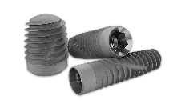
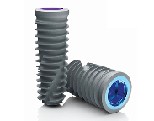
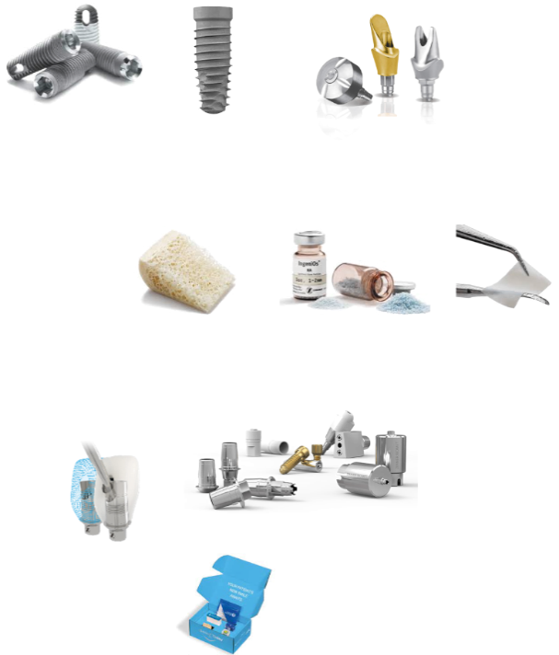



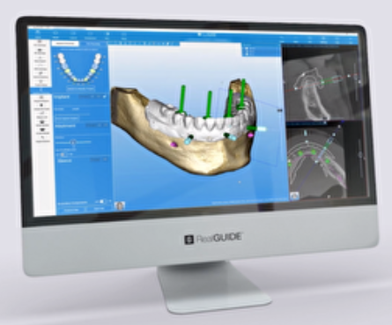
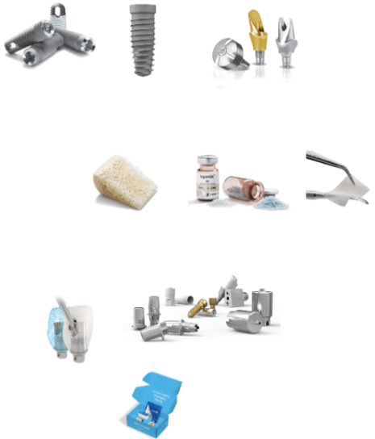

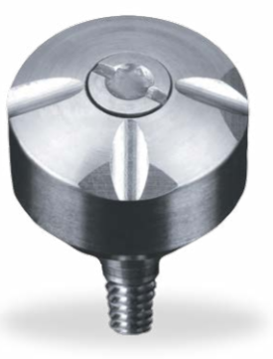
Dental Business Overview
Key Products
Tooth Replacement
Market
Dental Implants
Implants, surgical tools, abutments, restorative components
Dental Implants
TSX™
Implant
T3® PRO Implant
Full range of abutments, copings and analogs
Biomaterials
HSD
Growth
Digital Solutions
MSD
Growth
Biomaterials
Bone graft substitutes
Membranes
Tissue regenerative products
Puros®
Allograft
Xenograft and synthetic bone grafts
Barrier
Membranes
LSD-MSD
Growth
Digital Solutions
Intraoral scanners
CAD/CAM equipment
Treatment planning and designing software, surgical guides
RealGUIDE™
Software
GenTek™
System
BellaTek® System
Encode®
System
SmileZ Today®

Slide 7
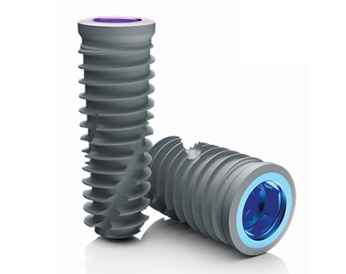
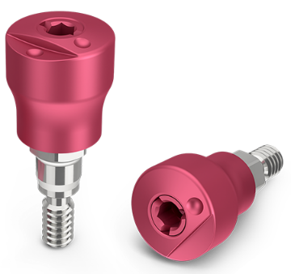
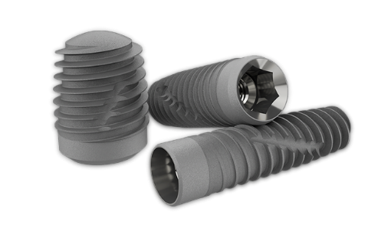
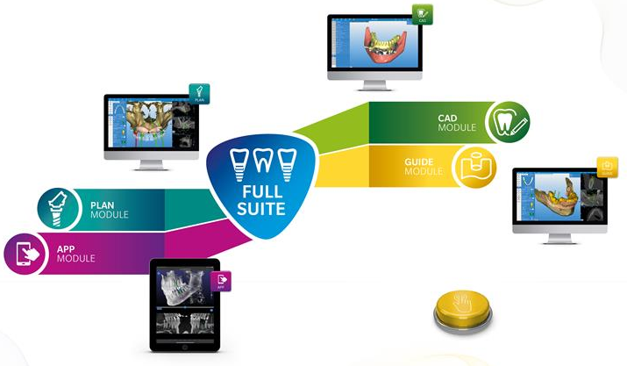

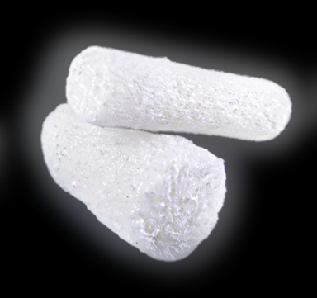
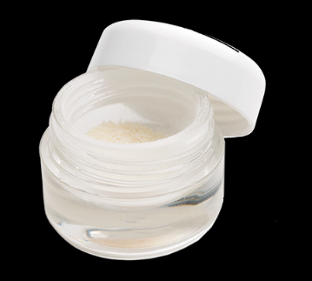
Recent Wave of Innovation
First new implant line in 10 years:
T3® PRO Implant
Encode® Emergence Healing Abutment
TSX™ Implant
Integrated Software Modules:
Holistic bone graft portfolio:
NEW
NEW
Best in Class
RegenerOss® Allograft
RegenerOss® Bone Graft Plug
Puros® Cancellous Particulate Allograft Plug

Slide 8
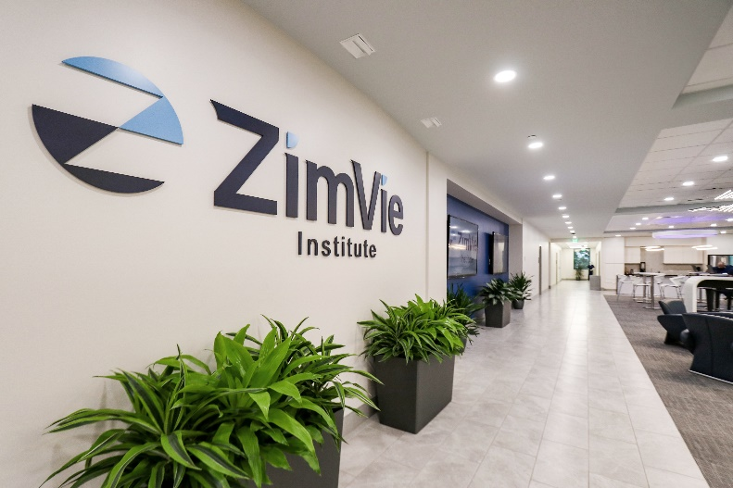
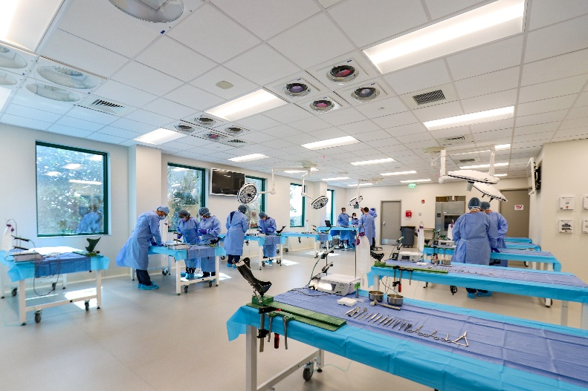
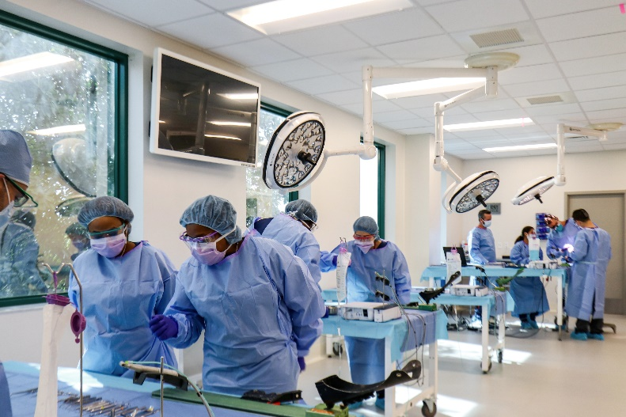
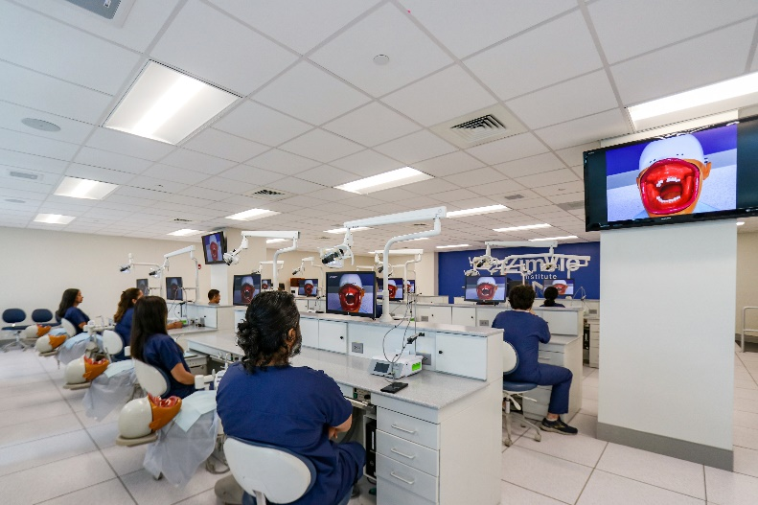
New State-of-the-Art Education and Training Institute
The “PBG Institute” in
Palm Beach Gardens, FL
Modern 11,000 Sq. Ft. Facility
Cadaver Lab
On-Site Mill
Fully Integrated Digital Workflow with 3D Printing & RealGUIDE™ Software
Co-located with manufacturing

Slide 9



ZimVie Dental: Excited for the Opportunity Ahead
Optimize Product Manufacturing
Drive capacity expansion and cost reduction across the portfolio
Manufacturing automation
Innovative Digital Workflow Solutions
Simplifying implant dentistry and improving clinical experience
Offering best-in-class services to drive practice growth and increase dental implant adoption
Penetrate and Expand Our Addressable Market
Drive adoption: 75% of eligible patients don’t receive an implant
Global new product introductions T3 PRO, TSX, RealGUIDE, Encode Emergence, and Implant Concierge
Innovation cadence will enhance share gains

Slide 10
Improving Spine Portfolio

Slide 11
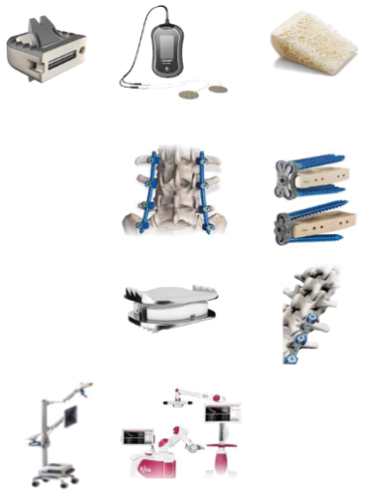
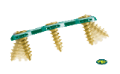

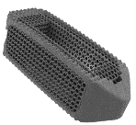
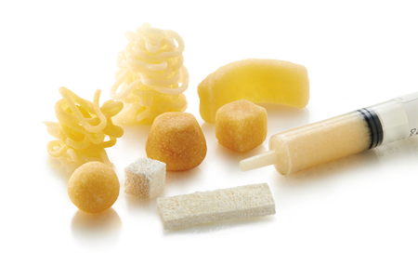
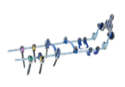
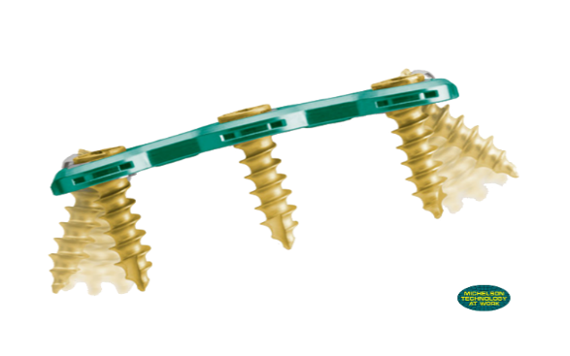
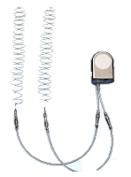

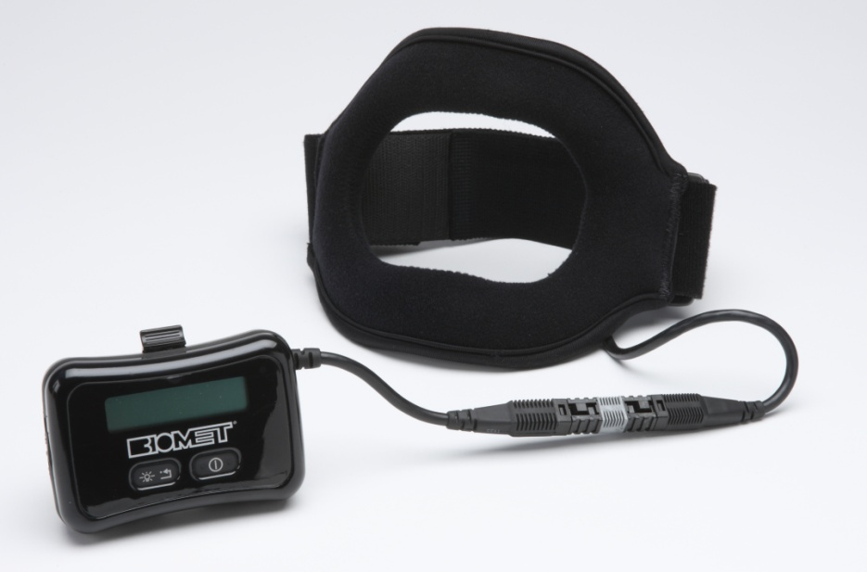
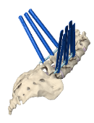
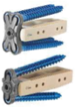
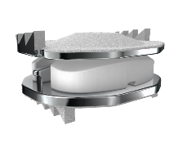

Spine Business Overview
Spine Surgery Market
Key Products
Core and Complex
Core & Complex
Bone Healing Technologies
Spinal fusion implants
Instrumentation
Biologics
Minimally Invasive Surgery (MIS)
and Enabling Technologies
ROI-C®
MaxAn®
Virage®
Vital™
TrellOss®
PrimaGen
Advanced™
Motion Preservation Devices
Bone Healing
MSD
growth
Non-invasive and surgical technologies to promote bone healing
SpF® Implantable Spinal
Fusion Stimulator
Non-Invasive
SpinalPak® & OrthoPak®
EBI Bone Healing
System® (PEMF)
Minimally Invasive Surgery
Spinal implants and instrumentation systems to support MIS approaches
Vital™ MIS
Timberline®
Lateral Fusion
Motion Preservation
Non-fusion alternatives to restore mobility or growth modulation
Mobi-C®
The Tether™

Slide 12
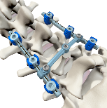
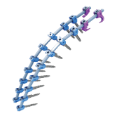
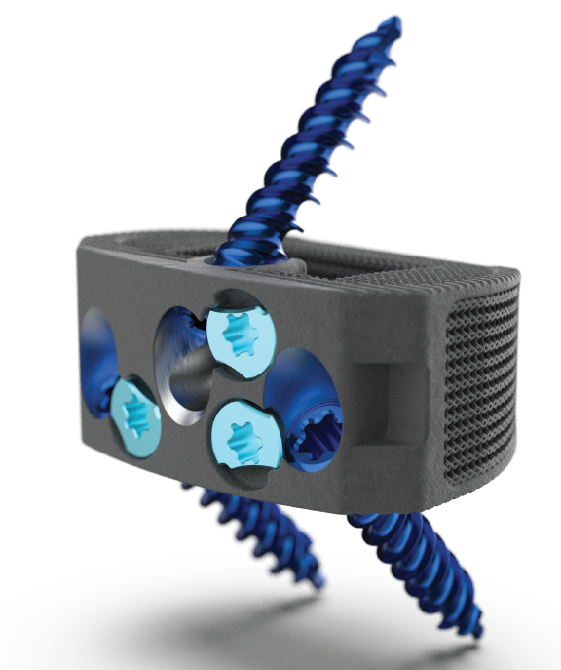
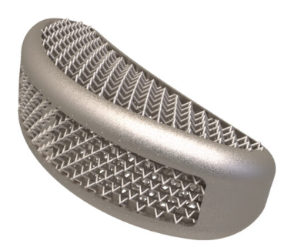
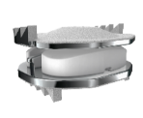
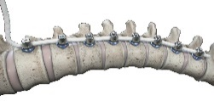

Repositioning for Growth
Refreshing Fusion Platforms:
NEW
NEW
Vital™ MIS
Platform
Vital™ Continuation
3d Printed Interbody Cages
NexGen Stimulation
Maintaining Motion Preservation Leadership:
Expanding into Enabling Technologies:
Recently Announced
Partnership and Global Development Agreement with Brainlab A.G.
Mobi-C™
The Tether®
Notes:
Brainlab partnerships is focused across IMAGING, PLANNING, NAVIGATION, and ROBOTICS

Slide 13


ZimVie Spine: Excited for the Opportunity Ahead
Mobi-C®
Leverage 10-year U.S. launch anniversary – outcomes focus
Drive product and clinical innovation – 200,000 discs implanted
Tackle key barriers to adoption
The Tether™
Deep focus on the top 20 U.S. metropolitan areas
Continue momentum internationally
Maintain market leadership with product and clinical innovation
Vital™
Ongoing enhancements to our Vital Pedicle Screw platform
Focus on MIS, Complex Spine, navigation and robotic compatibility
Optimize offering for the ASC

Slide 14
Accelerating Operational Independence

Slide 15
Significant Progress in 1st Year as an Independent Company
ERP & Core IT Systems Refresh
950 servers moved to new data center; 232 applications transitioned
Completed major ERP conversions to a Modern Oracle Cloud first approach
Microsoft 365 implemented and leveraged for network security
Facilities
Closed Parsippany, NJ, and Bordeaux, France sites
Reduced footprint at Westminster, CO, and Troyes, France sites
Transforming Palm Beach Gardens, FL into Flagship Center of Excellence
Manufacturing & Distribution
Improved Spine distribution fill rates from 62% to above 95% on-time and in full
Reduced Spine inventory by over 10% and days on hand by over 18% in 2022
Plans in-place to continue value capture in FY23 through FY26+

Slide 16
2023 Financial Guidance
Third Party
Net Sales:
    $835M - $860M
Adjusted EBITDA^{[1]} Margin:
    13.5% - 14.0%
Adjusted Diluted EPS^{[1]}:
$0.40 - $0.60
^{[1]} This is a non-GAAP financial measure for which a reconciliation to the most directly comparable GAAP financial measure is not available without unreasonable efforts. Refer to “Forward-Looking Non-GAAP Financial Measures” in this presentation, which identifies the information that is unavailable without unreasonable efforts and provides additional information. It is probable that this forward-looking non-GAAP financial measure may be materially different from the corresponding GAAP financial measure..

Slide 17
The Opportunity Ahead

Slide 18

The ZimVie Opportunity
Positioned to expand large, attractive, underserved markets through differentiated solutions and an innovative pipeline
Strong dental business with leadership position in biomaterials, digital dentistry, and premium implants
Spine business with #1 market leadership in two important categories - cervical disc replacement and vertebral body tethering
Driving margin expansion and improving free cash flow with a disciplined financial framework
Demonstrated organizational capability for transformation, allowing us to rationalize infrastructure, modernize IT systems and accelerate independence from legacy entanglements

